Slide 1
Workspaces & Algorithms

Slide 2
Overview
Workspaces
Algorithms
How do they play together?

Slide 3
Workspaces
The data structures for MANTID
Written in C++
Different classes store data differently:
Workspace2D
EventWorkspace
TableWorkspace
+ other more specialized types that are not often used
MatrixWorkspace is base of EventWorkspace & Workspace2D

Slide 4
Common Workspace Properties
Workspaces hold more than the data:
Instrument geometry
Experiment logs
Run start/stop,
Proton charge
Sample temperature + many more
History of operations on workspace

Slide 5
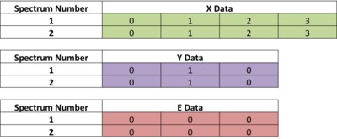
MatrixWorkspace/Workspace2D
MatrixWorkspace provides a histogram interface to data
Workspace2D stores the actual histograms (a vector of Histogram objects that can contain point data!)

Slide 6
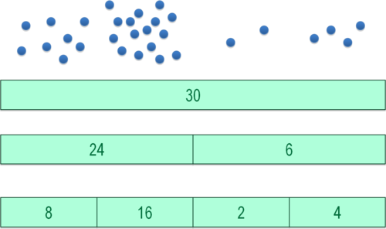
EventWorkspace
EventWorkspace holds “buckets” of timestamped events per spectrum
Provides on-the-fly histogram representation

Slide 7
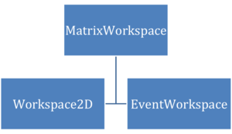
Relationships

Slide 8
Algorithms
Encapsulate operations
Written in C++ or Python
Provide consistent interface to setup and run some operation
An algorithm defines a list of input/output properties
Properties encapsulate input/output arguments
Majority operate on workspaces
Perform some transformations on data
Python functions for users are automatically generated

Slide 9
Algorithms & Analysis Data Service (ADS)
Workspace given a name by adding it to the Analysis Data Service (ADS)
Users generally just know this as the “Workspaces List”
Algorithms considered in one of 2 “modes”:
Parent:
Algorithm adds output workspace(s) to ADS at end of execution
History record is added to the workspace
Child:
Output workspaces are not added to the ADS by default
No history is recorded
Use `createChildAlgorithm` inside a parent algorithm to set on up

Slide 10
Workflow Algorithms
WorkflowAlgorithms are special types that only call other algorithms
History records sub-algorithms called on workspace
Great for encapsulating the workflow for a GUI

Slide 11
MESSAGE ENDS

